Slide 1
Fake Job Postings
BITS Datathon Fall 2022
Busch Consulting Group
Joann Lariza, Anish Gupta, Yingfan He
Notes:
Hello, we’re the Busch Consulting Group and we did an analysis of fake job postings for our submission for the BITS Fall 2022 Datathon.

Slide 2
Abstract
Fake job postings are becoming more commonplace, as many individuals are seeking out opportunities online. These are often created to steal people’s information and identities for one’s own benefit.
In 2020, 16,021 people reported being victims of employment scams, with losses totalling over $59 million
Specifically in Texas, 1,720 victims reported $4.5 million in losses
Notes:
In recent years, reports of fraudulent job postings on the internet have surged as more and more people rely on the internet when searching for employment opportunities. These fake job postings are typically used to steal personal information and identities from unassuming applicants for malicious purposes. In 2020, it was reported that 16,000 people fell victim to these employment scams, which led to losses of over $59 million dollars. In Texas alone, $4.5 million dollars were lost from over 1,700 victims.

Slide 3
Objective
What are the signs of fake job postings?
What employment type do they most often list?
Which industries are they more likely to appear in?
What experience and education do they require?
What are the average salary ranges offered by industry?
Where do fake job listings appear most frequently?
Common word tags used?
Notes:
Our goal for this analysis was to identify the signs of a fake job posting. We proposed 6 questions regarding fake job postings to answer with our analysis: What employment type is most common in the dataset, which industries are they most likely to appear in, what experience and education are required, what are the average salary ranges offered by industry, where do fake job listings appear the most, and what common word tags are used across these posts.
By answering these questions, we hoped to identify a pattern that allows one to spot a job posting as fraudulent.

Slide 4
Our findings
Let’s dive deeper
Notes:
So now that we’ve introduced to you the premise of our research, let us now look at our findings.

Slide 5
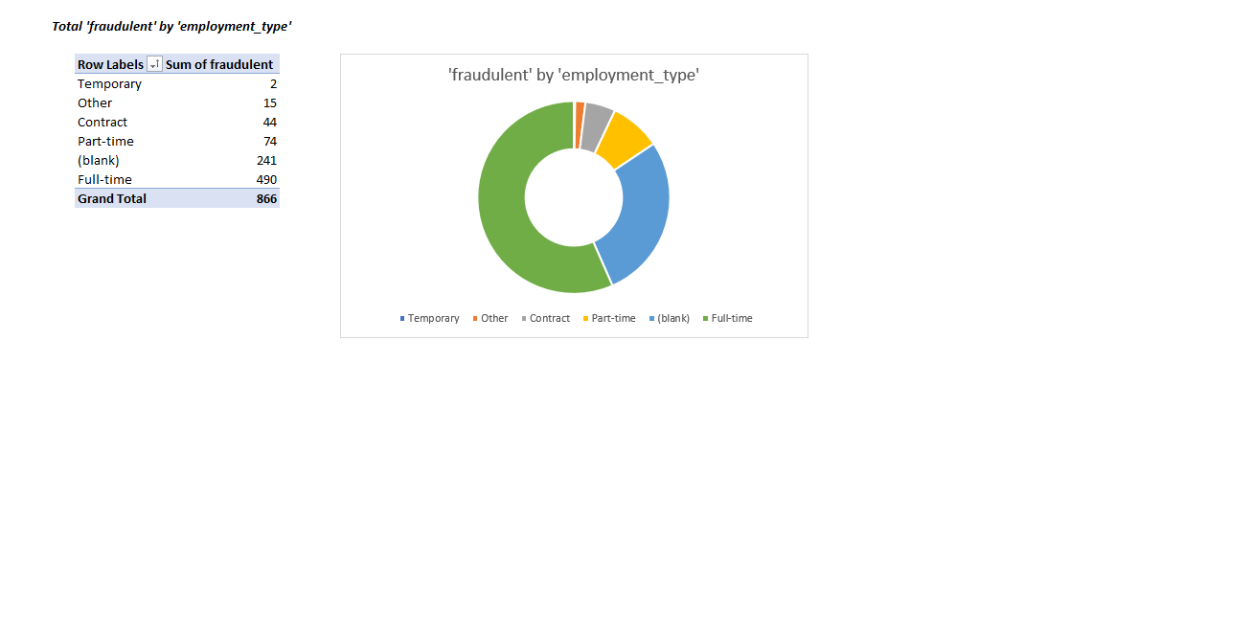
Looking at the employment types in fraudulent job postings
Amongst fake job postings, full-time employment were most common, followed by unspecified employment.
Notes:
In our analysis of over 800 fraudulent job postings online, we found that the majority of these fake job postings were advertised as full-time positions, followed by unspecified unemployment type.

Slide 6
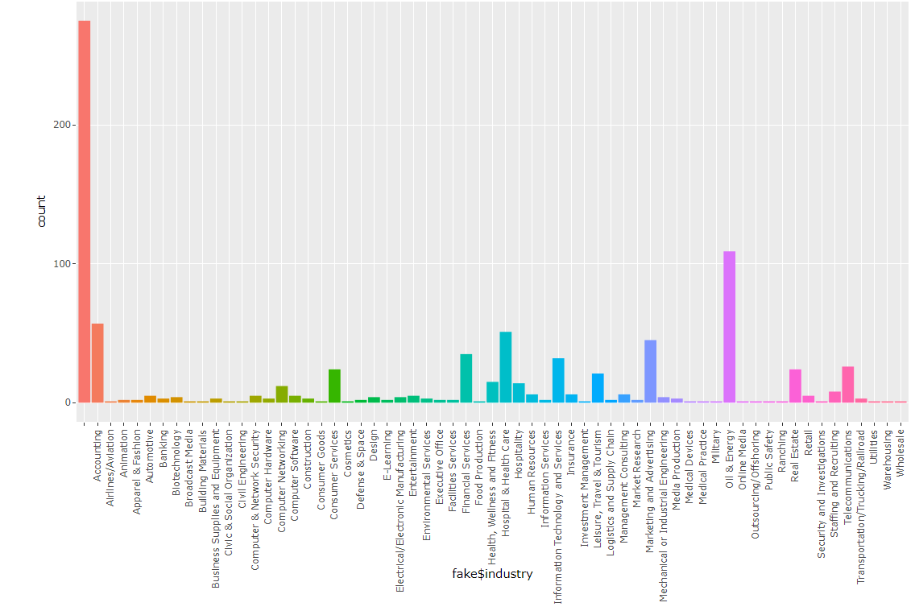
Fake Jobs in different industries
Many fraudulent job postings were unspecified, however there was a large portion of job listings that was listed under oil and energy
* interactive graph can be found in the repository
Notes:
Note from Joann to Joann change the graph w colors + title

Slide 7
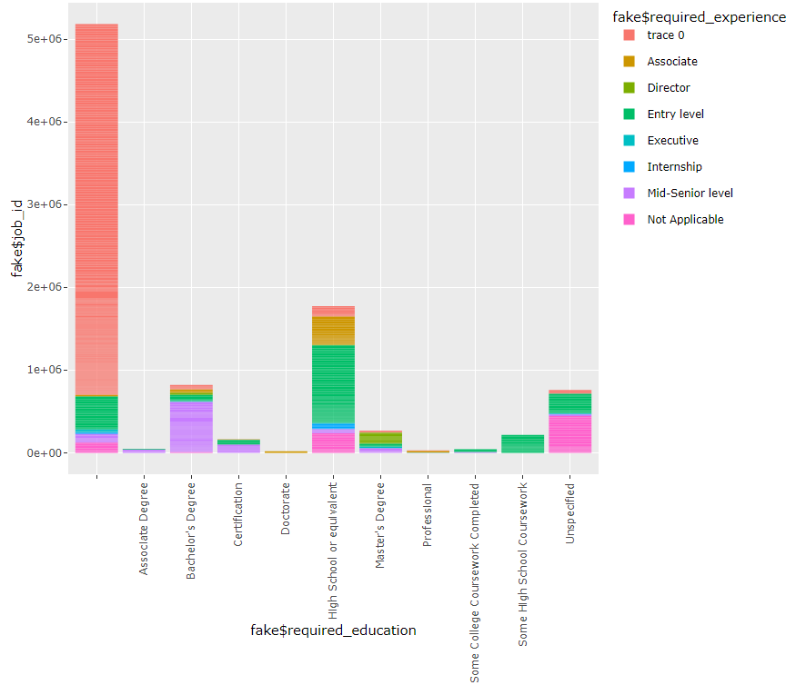
Required experience vs required education
Amongst fraudulent job postings, many didn’t require experience, nor any education. However for those that did, they required at least a high school diploma
*interactive graph can be found in the repository
Notes:
Our analysis also found that many of these fraudulent job postings did not require any experience or education for their positions. However, for the job postings that required experience or education, we found that they required at least a high school diploma.

Slide 8
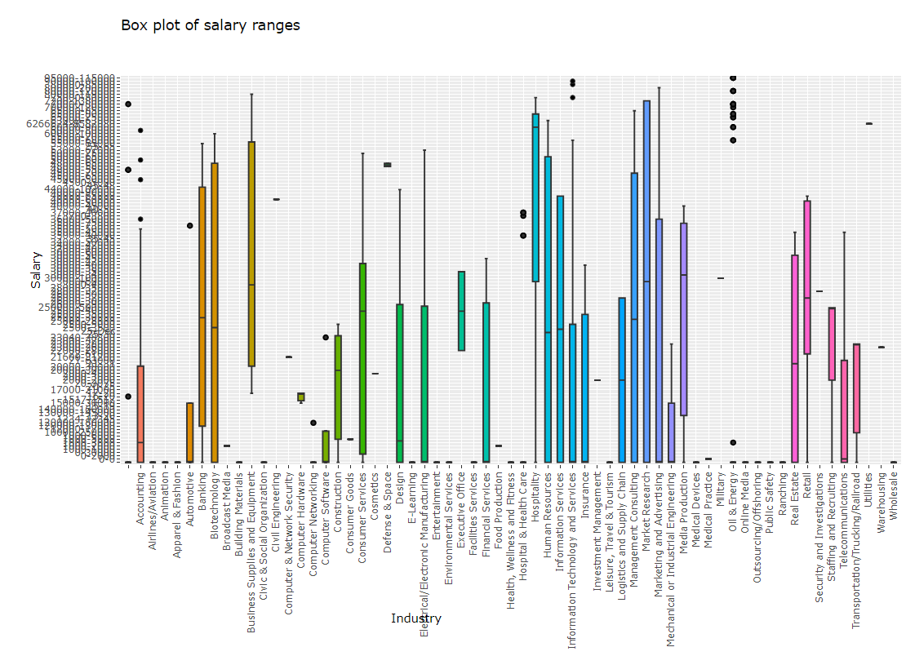
Salary range vs industry
The human resources department, had the highest average salary ranging from $60K - $90K
*interactive map can be found on the repository
Notes:
Looking at the fraudulent job posting data we cleaned, we wanted to analyze the five points summary for each industry. We found that within the human resources department, they had the highest average of $60K-$90K. Many of the other industries had outliers that went into the hundreds of thousands range.

Slide 9
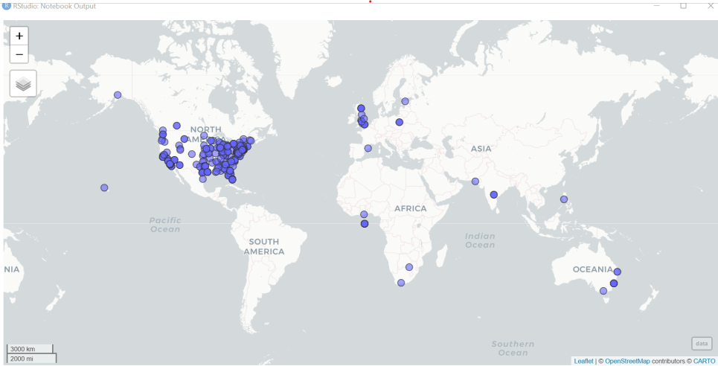
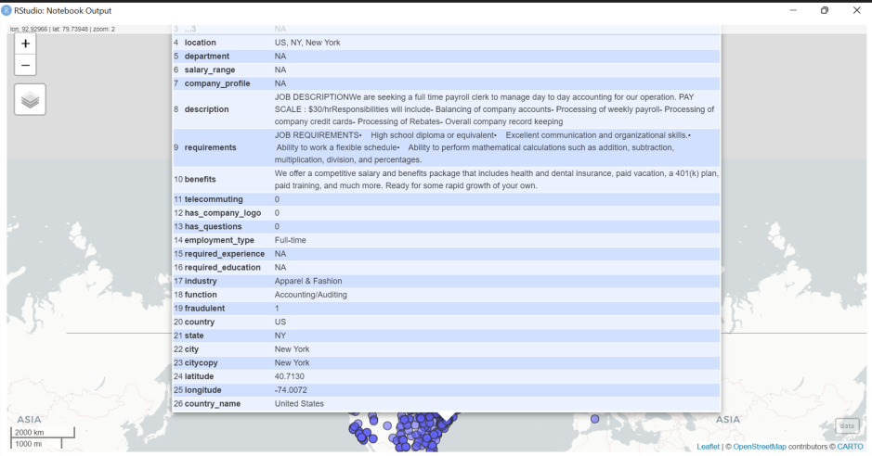
Fraudulent job postings around the world
This map shows all the fake jobs in our dataset on a world map. It appears that most of the fake jobs are clustered in the United States. When we click on individual jobs, we are able to view all of the details of the job posting.
Notes:
Anish - This is an interactive world map that shows all the fake jobs in our dataset on a world map. It appears that most of the fake jobs are clustered in the United States. When we click on individual jobs, we are able to view all of the details of the job posting.

Slide 10
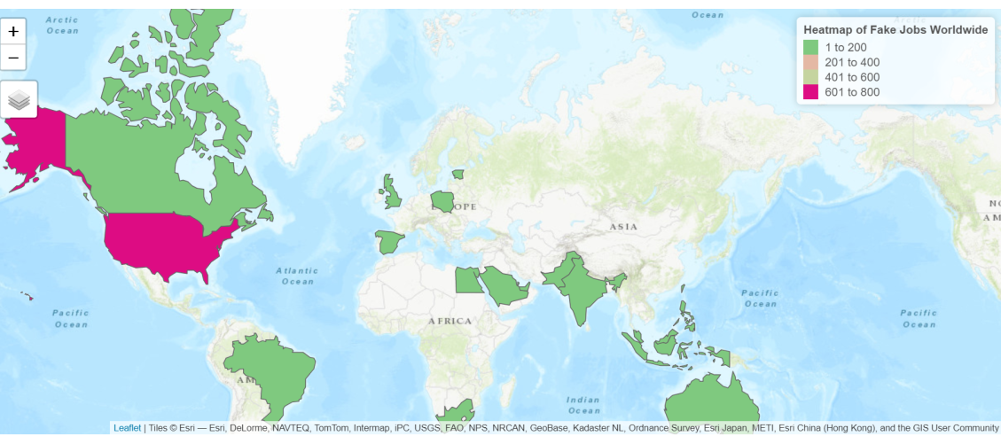
Fraudulent job postings around the world (cont.)
We discovered that, of the job listings we tested, the United States had the highest number of fake postings, at 730.
Notes:
We created a global heat map to visualize the countries represented in the dataset. As you can see, the majority of the fraudulent job listings in the dataset were located in the United States. Of the 800+ fake job postings that we analyzed, we found that the United States had the highest number of fake job postings, at a whopping 730 posts.

Slide 11
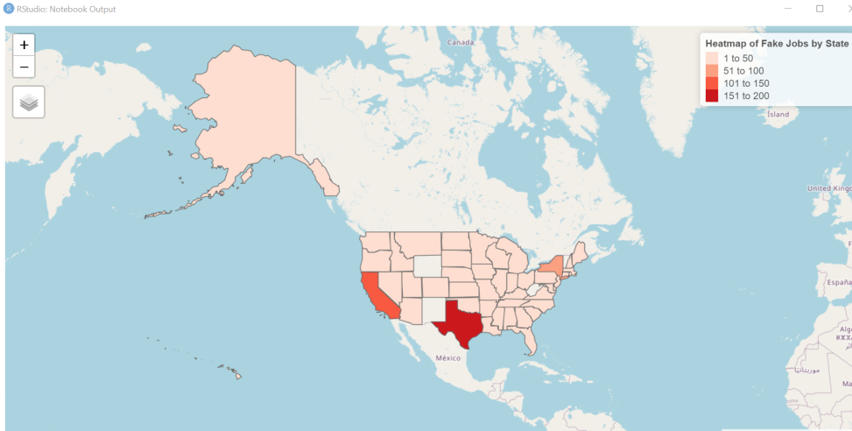
Fraudulent job postings in the US
Within the U.S., most fake job postings were found in Texas, followed closely by California and New York
*interactive graph found on the repository
Notes:
Going back to the US, we found that the majority of fake job postings in the United States were found in Texas, followed closely by California and New York.

Slide 12
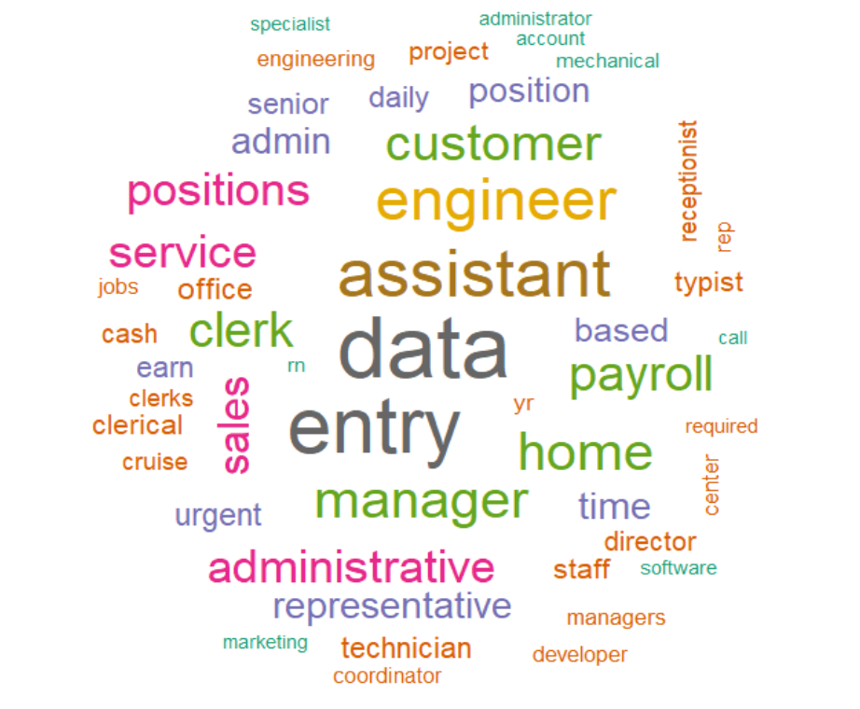
Word Cloud of Job Titles
The word cloud shows that data entry is the most common job title among fake jobs.
Notes:
Anish - We analyzed job title keywords by creating a word cloud and the keyword data entry had the most occurrences followed by the keyword assistant.

Slide 13
Conclusions
Many job postings that are fake are often unspecified in their target industry. That means no experience nor any education (which sounds too good to be true!) Their main objective is to catch anyone and everyone if possible to obtain any type of personal information.
That being said, many fraudulent job postings are listed in the oil and energy industry, and are located in the U.S., specifically in Texas, California, or New York. For those looking in the human resources department, they may tempt you by offering a $60K-$90k salary. They are looking for people interested in full-time employment and require at least a high school diploma
Notes:
From our analysis, we concluded that the majority of fake job postings tend to be unspecified in their target industry. It appears that most of these malicious parties intend to primarily target those with no experience or education based on their minimal requirements in their fake postings. If a job seems too good to be true with overly generous salaries and minimal job requirements, it most likely is fake! Cyber criminals will stop at nothing in order to steal sensitive information such as social security numbers and other personal documents. With that being said, the majority of these fraudulent job postings were listed in the oil and energy sector and were located in the U.S., specifically in the states of Texas, California, and New York. Those looking at jobs in the human resources department may see offerings of $60-90K. These fake listings were all advertised as full-time positions and required at least a high school diploma.

Slide 14
Takeaways from the Busch Consulting Group
After another weekend of late nights and looking up articles, the Busch Consulting Group was happy to come together to create another project.
Cleaning the dataset in Excel
Numerous locations in the dataset were spelled or formatted incorrectly
We normalized the location data to a consistent format and also generated coordinates for each location to assist in visualization
Creating advanced graphs in R
We learned how to utilize new libraries (such as ggplotly and tidyverse) to make our graphs interactable, which is a lot more than what we accomplished last datathon
However
Attempted to create a prediction model
Cleaning and separating the data would take up too much time, so we decided to delegate our time to more important tasks
Attempted to create spider/radar charts
The layout of a typical radar chart is hard to read and may misrepresent information, so we decided to stick to easier to read visualizations for the sake of our audience
Notes:
After another weekend of late nights and lengthy research, the Busch Consulting Group was happy to come together to create another project. Throughout the course of the project, we learned and implemented a variety of new data analysis techniques. Our dataset, which we sourced from Kaggle, contained numerous misspellings and improperly formatted data. Using Excel, we normalized the data to a format consistent for us to use for analysis. We also generated the longitude and latitude for the locations in the dataset, which assisted us in plotting the data on the map. For our analysis, we primarily used R. We learned how to utilize new libraries such as ggplotly and tidyverse in order to make our graphs interactable, which was a huge step from our static visualizations from the last datathon. However, we did run into some difficulties while completing our project. We attempted to create a prediction model; however cleaning and separating the data would have required too much time, so we decided to prioritize more important tasks. We also attempted to create spider charts, which while visually appealing, can be hard to read and may misrepresent information, so we made the decision to stick to easier-to-read visualizations for the sake of our audience.

Slide 15
Our hopes for this project
We hope that our audience will be able to take away knowledge of the attributes of fake job postings. Especially as we are in the midst of recruiting season for Spring 2023 internships and co-ops, we wish everyone the best of luck finding new opportunities. When looking on LinkedIn, Handshake, or other job search engines, everyone should remain vigilant and proactive when researching possible places of employment and be careful when distributing personal information. We hope that if you see any suspicious postings, you report them immediately by using the conclusions we provided.
Notes:
We hope that after our presentation that the audience walks away better informed on this epidemic of fake job listings. Especially as we are in the midst of the recruiting season for Spring 2023 internships and co-ops, we wish everyone the best of luck in finding new opportunities. When looking on LinkedIn, Handshake, or other job search engines, everyone should remain vigilant and proactive when researching possible places of employment and be careful when distributing personal information.

Slide 16
Thank you! Dataset: https://www.kaggle.com/datasets/shivamb/real-or-fake-fake-jobposting-prediction Github Repository: https://github.com/jplariza/Analysis-of-Fake-Job-Postings
Find us on LinkedIn: Joann Lariza: https://www.linkedin.com/in/joann-pauline-lariza/ Anish Gupta: www.linkedin.com/in/anish-gupta-b67865237 Yingfan He: https://www.linkedin.com/in/yingfan-he/

